Slide 1
Infinite Loop - Personal Budgeting System
Team Members:
- Abdelrahman Ashraf Mohamed (20230610)
- Omar Mostafa Saad Mohamed (20230267)
- Yousef Hesham Ali (20230515)

Slide 2
Architecture Overview
Client-server model using API interaction.
Backend handles auth, transactions, payments.
Frontend: Web & Mobile apps.

Slide 3
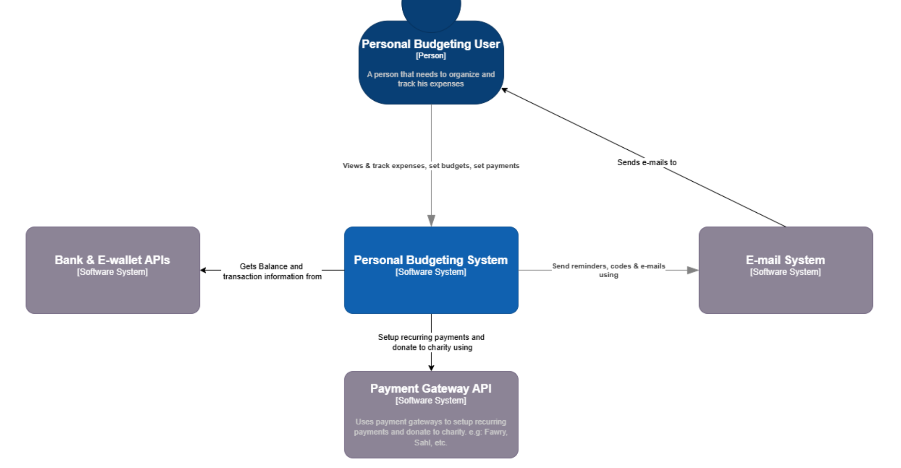
Architecture Overview

Slide 4
Class Diagram
User, Income, Expense, Budget, Reminder, Goal, Debt, Donation, Report
UI + Controller classes for each component.

Slide 5
Sequence Diagram
Covers flows like Sign Up, Log in, Add Income, Add Budget, Add Expense, Add Reminder.
Interactions between UI → Controller → Model.

Slide 6
State Diagram
Budget Lifecycle: Created → Edited → Deleted → End

Slide 7
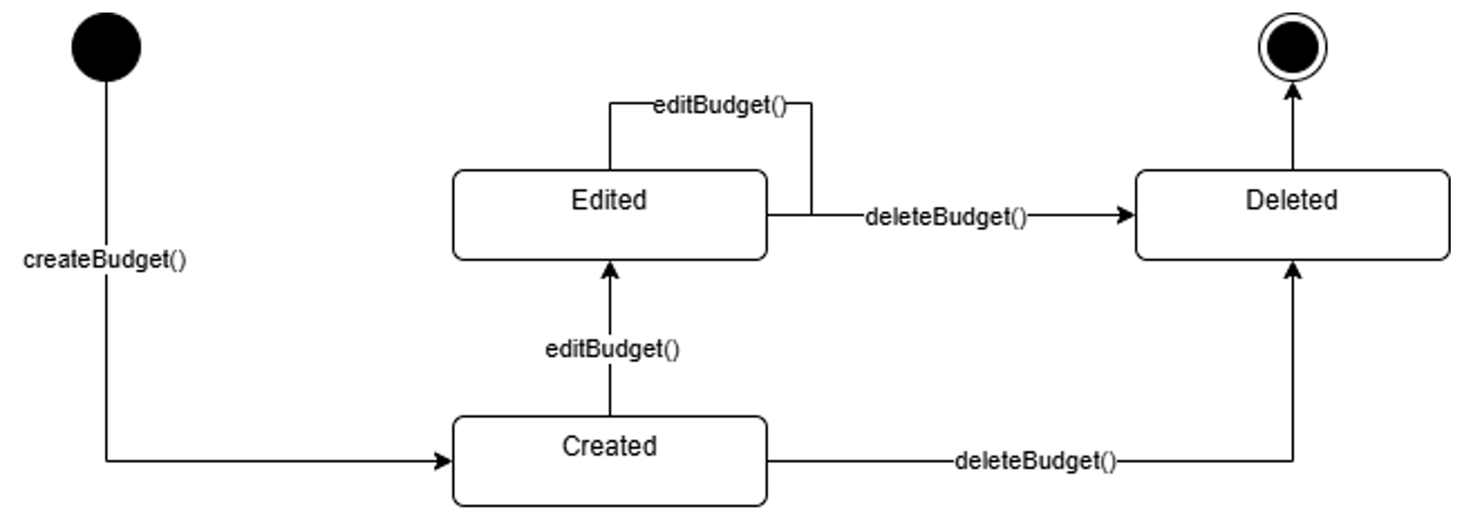
State Diagram

Slide 8
Design Patterns & SOLID
SOLID: SRP in AuthController, OCP via PaymentGateway, DIP in BudgetController.
Patterns: Observer, Singleton, Bridge.

Slide 9

How we made the application ?

Slide 10
How we made the application ?
We made a console application using java that uses sqlite to store its data.
We made 2 classes to handle auth process after it ends the rest of the program gets user object and receives controls
Each one of the rest of the classes is used as middleware between user and DB.

Slide 11
Code Structure
/src for source, /lib for libs, /bin for compiled code.
/src/Classes contains the classes that the code uses.
/lib contains sqlite driver.

Slide 12
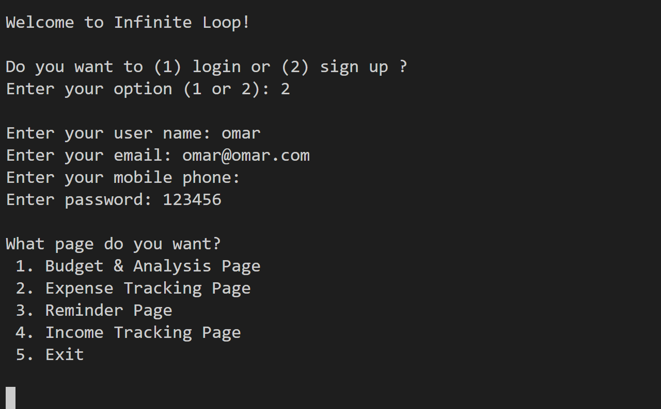
Live Program

Slide 13
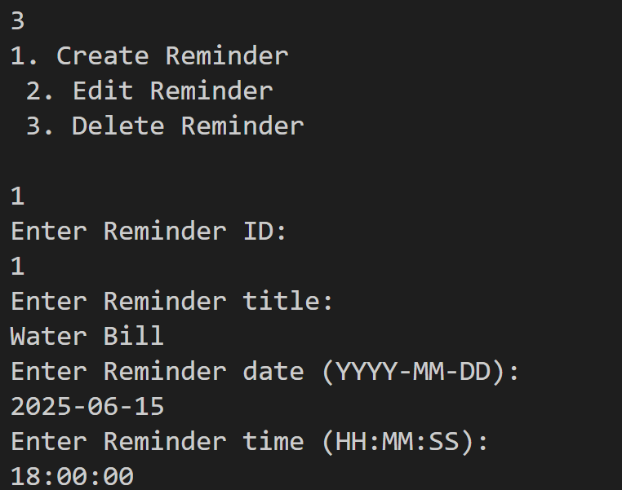
Live Program

Slide 14
Technologies
Java, GitHub, SQLite.
Diagrams via Lucidchart, Draw.io, Visual Paradigm.

Slide 15

Tech Radar

Slide 16
Tech Radar
UV: A Next-Generation Python Package Manager
Renovate: A Comprehensive Dependency Management Tool
Vite: A High-Performance Front-End Build Tool

